Slide 1
> 3T Working Group Updates 3T Terminology, Taxonomy, Technology - Definition Release Plan - Whitepaper - Phase II Release - Security and Trustworthiness Subgroup Update - Platform Stack → Open Source > New Working Group Healthcare and Life Science > Liaison and Regional Branch Update
Organizational Overview

Slide 2
Technology, Terminology & Taxonomy Working Group
Terminology
Security
Trustworthiness
Common Characteristics
Enabling
Technologies
Platform
Stacks
Taxonomy
Types

Slide 3
Technical Reports: Phased Release Proposal
Phase 1 – Doc Release
Definition / Description
Phase 2 – Doc Release
Stack/Lifecycle
Phase 3 – Doc Release
Use Case/Case Study
Introduction and Scope
Definition Process
What is included
What is Excluded
Vocabulary and Terminology
Definition
Supporting Statements
Elaboration Description
TBD:
Types of Digital Twins
High level view - Taxonomy
Platform Stack
Layered stack diagram
Open Source consideration
External Data provisioning
Lifecycle Phases
Digital Twin View (Virtualized)
Asset / Entity View (OT)
Maturity Model
Framework
Common Characteristics
Enabling Technologies
Blueprint: Reference architecture
Use Cases Examples
High Level - overview
Case Study – advance view
Next Installment
Updates on Use case analysis
Case Study detail
ROI , Business Outcome, Value at Stake
References
Platform 4.0 and IIC DT Admin Shell WP
Digital Twin Whitepapers utilized
…
Notes:
1 week to 2 weeks for iteration

Slide 4
Focus – Security and Trustworthiness Sub-Group
Terminology
Security
Trustworthiness
Common Characteristics
Enabling
Technologies
Platform
Stacks
Taxonomy
Types

Slide 5

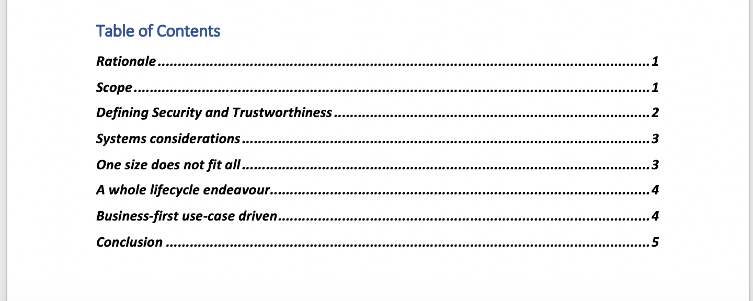
Position Whitepaper

Slide 6

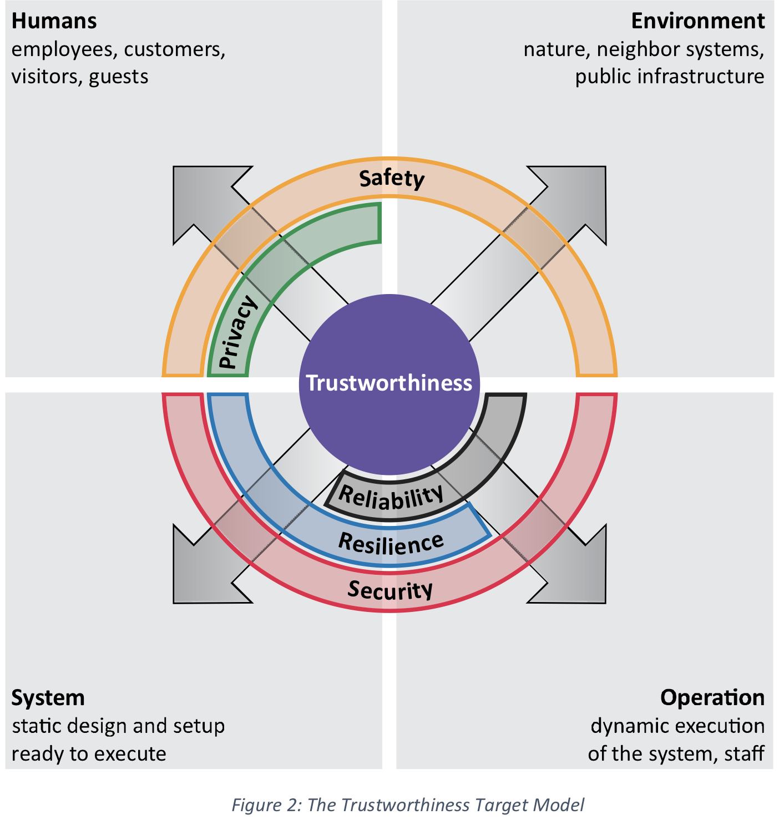
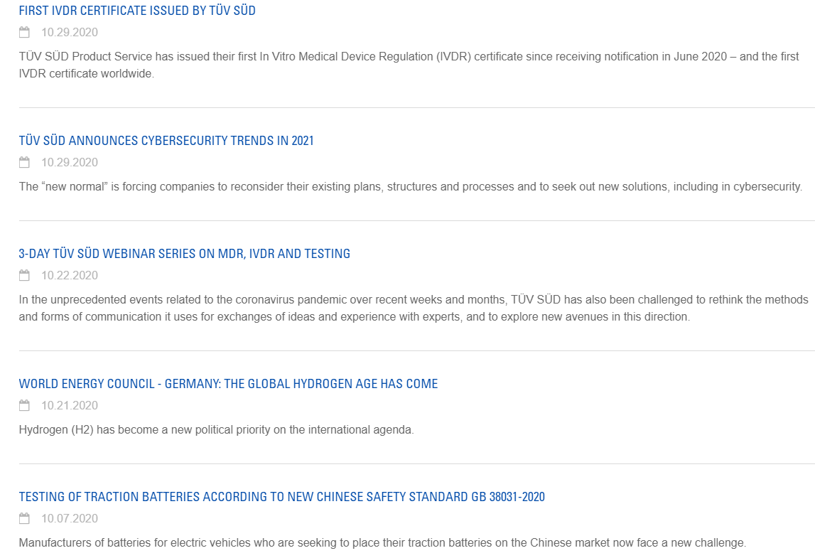
New Member: TUV SUD Lead effort on Safety , Reliability

Slide 7
Expanded Stack
Systems of Digital Twins / etc.
…
Real World
Security, Trust, & Governance
Privacy
Applications
& Services
Applications
Synchronisation Mechanisms
Digital
Twin
System
Security
Visualisation / Render Services
Analytics
Services
Service Interfaces
Service Interfaces
Safety
Digital Twin
Simulations / Predictive Models
Management & Automation
Representational Models
Resilience
IT/OT Platform
Software Platform / Tooling Stack
Platform APIs
Reliability
Orchestration
Compute
Networking
Data Storage

Slide 8
System(s) of Digital Twins
WIP
Apps & Services
Apps & Services
Analytics
Visualisation
Web
Dashboard
(e.g. BI)
Instantiation of the Digital Twin from Real World Data
Synchronisation/updating the Digital Twin with Real World Data
User
Interfaces
Digital Twin System
Rendering
Engine
Virtual
Representation
Synchronisation Mechanisms
Digital
Twin
Service
Interfaces
Services Interfaces
IoT
Systems
Protocols
AIs
Real World
Data Integration
Predictive
Models
Representational
Models
APIs
Realisation of the impact in the Real World
Interoperability
Model
Integration
Simulations
Security, Trust, & Governance
Orchestration
Networking
Compute Platform
IT/OT
System
Personnel
/ People
Compute
Data
Storage

Slide 9
Expand Platform Stack to 3T Sub-Group: Include Focus on Open Source
A Digital Twin workflow (from engineering model to embedded code)
The key technologies required to build a multi-physics, equation-based, twin
(Modelica, Julia, Ansys Simulation, etc.)
The key technologies for integrating equation-based twin with the information twin
(MSFT Twin Builder, DTDL, DDS, etc.)
The key technologies needed to interface the equation-based twin with automation and control systems (IEC 61131, IEC61499, IEC 61508 etc.)
The pathway to develop Opensource modeling languages and reference models that allow us to:
Build Multiphysics models for systems of systems
Interface automation & control systems with the models
Interface the equation and information models
Export engineering quality control code from the model
Export embeddable code from the model that can be used at the edge
Co-simulate models from different vendors
(e.g. an FEA or CFD model run in-the-loop with an automation model)

Slide 10
Healthcare and Life Science

Slide 11
Planned New Working Group Focus Areas
To Explore Use Cases for Digital Twins in Healthcare and Life Science
Clinical diagnostic; sensors for electroencephalography (EEG) and electrocardiogram (ECG);
Real time health system (RTHS) capabilities to provide real-time monitoring and other data sources that can lead to better-informed care pathways
To Define and Identify Types of Applications for Digital Twins in Healthcare and Life Science
Pharma research and development
Care delivery (e.g. clinical communication and collaboration)
Patient engagement (e.g. Interactive patient care)
Facilities and operations (e.g. RTHS supply chain)
Management and administration (e.g. Health care information exchange)
To Explore & Identify Implementation Scenarios for Healthcare and Life Science Digital Twins
Explore combining data from multiple sources to expose the measurable effect of one biological system on another
Providing a more detailed and quantitative view of a patient – “Digital Twin of Self”
Remove gaps in information available to give the physician the greatest opportunity to understand overall health
Provide patients holistic view for continued wellness in the most efficient possible manner
Provide technology-based mechanisms to collect accurate data for the various decision contexts within the Healthcare delivery organization
Co-Chair Meeting: HealthSkouts: Dr. Koen , Dell Life Sciences
Infrastructure: Established on Causeway
Kick-off meeting: Post - Member meeting introduction

Slide 12
Initial Healthcare and Life Science Working Group Members
Dell - Life Sciences
HealthSkout -Digital Twin of Self
Microsoft - Lifesciences division
Thynkli - digital twin coordination / integration Life science -pharma and healthcare
Gafcon - digital twin of system of systems
Slingshot - Bio -Modeling w/ real world data
Green Alliance -Life Science technology
Well Care - Healthcare
Dr. Kutter - email - FDA , Governance
Dr. Joanthan Mcoy - Family Care Space
Brian Stark - Banta Medical
iVeia - Life Sciences
Jon Geater - Jitsuin - Privacy
Strong interest from Members
Life Sciences
Wellness Centers
Healthcare approaches
Organizational focus
Practitioners – MDs
Implementers of Digital twins
Co -Chairs Identified
Life Science & Healthcare
Proposed Charter in review
Initial Objectives identified
Align to Digital Twin Lifecycle

Slide 13
Growth: Liaisons & Regional Teams

Slide 14
Liaisons – Collaborations in Progress
IIC - Signed
Building Smart- Signed
CDBB – Center for Digitally Built Britain - in progress
CPC - Construction Progress Congress – in progress
SCCANZ – Smart City Council for Australia and New Zealand – In progress
Platform 4.0 Industry - in progress
AI Med - Medical – in progress
Singapore Virtual City – in progress (via ASTAR)
CABA – Continental Building Association
GMG - Global Mining Group
Austmine – Australia Mining
OSMG – Open Source Modelica Group
IDTA – Discussions in progress
OMP –Open Manufacture Platform (Bosch , MS)

Slide 15
Strategic Objectives of Digital Twin Consortium Regional Teams
The purpose of a Regional Team is to facilitate local Digital Twin Consortium activities that can sometimes be hindered by language, culture and time zones, and to take advantage of access to local officials and official documents.
Regional teams and their meeting are open to all Digital Twin Consortium members and will be held at the convenience of regional members in terms of language, culture and time zones.

Slide 16

Regional Team Expansion In Progess
Africa
Australia
Canada
Germany
Italy
Japan
Korea
Spain
North America
South America
Italy:
Manufacturing
Chile:
Sustainable Foods
Water Management
Nigeria, Ghana:
Transportation & Energy
Notes:
;;;;;;;;;;;;;;;;;;;;;;;;;;;;;;;;;;;;;;;;;;;;;;;;;;;;;;;;;;;;;;;;;;;;;;;;;;;;;;;;;;;;;;l;;;;;;;;;;;;;;;;;;;;;;;;;;;;;;;;;;;;;;;;;;;;;;;;;;;;;;;;;;;;;;;;;;;;;;;;;;;;;;;;;;;;;;;;;;;;;;;;;;;;;;;;;;;;;;;;;;;;;;;;;;;;;;;;;;;;;;;;;;;;;;;;;;;;;;;;;;;;;;;;;;;;;;;;;;;;;;;;;;;;;;;;;;;;;;;;;;;;;;;;;;;;;;;;;;;;;;;;;;;;;;;;;;;;;;;;;;;;;;;;;;;;;;;;;;;;;;;;;;;;;;;;;;;;;;;;;;;;;;;;;;;;;;;;;;;;;;;;;;;;;;;;;;;;;;;;;;;;;;;;;;;;;;;;;;;;;;;;;;;;;;;;;;;;;;;;;;;;;;;;;;;;;;;;;;;;;;;;;;;;;;;;;;;;;;;;;;;;;;;;;;;;;;;;;;;;;;;;;;;;;;;;;;;;;;;;;;;;;;;;;;;;;;;;;;;;;;;;;;;;;;;;;;;;;;;;;;;;;;;;;;;;;;;;;;;;;;;;;;;;;;;;;;;;;;;;;;;;;;;;;;;;;;;;;;;;;;;;;;;;;;;;;;;;;;;;;;;;;;;;;;;;;;;;;;;;;;;;;;;;;;;;;;;;;;;;;;;;;;;;;;;;;;;;;;;;;;;;;;;;;;;;;;;;;;;;;;;;;;;;;;;;;;;;;;;;;;;;;;;;;;;;;;;;;;;;;;;;;;;;;;;;;;;;;;;;;;;;;;;;;;;;;;;;;;;;;;;;;;;;;;;;;;;;;;;;;;;;;;;;;;;;;;;;;;;;;;;;;;;;;;;;;;;;;;;;;;;;;;;;;;;;;;;;;;;;;;;;;;;;;;;;;;;;;;;;;;;;;;;;;;;;;;;;;;;;;;;;;;;;;;;;;;;;;;;;;;;;;;;;;;;;;;;;;;;;;;;;;;;;;;;;;;;;;;;;;;;;;;;;;;;;;;;;;;;;;;;;;;;;;;;;;;;;;;;;;;;;;;;;;;;;;;;;;;;;;;;;;;;;;;;;;;;;;;;;;;;;;;;;;;;;;;;;;;;;;;;;;;;;;;;;;;;;;;;-------------------------------------------------------------------------------------------------------------------------------------------------------------------------------------------------------------------------------------------------------------------------------------------------------------------------------------------------------------------------------------------------------------------------------------------------------------------------------------------------------------------------------------------------------------------------------------------------------------------------------------------------------------------------------------------------------------------------------------------------------------------------------------------------------------------------------------------------------------------------------------------------------------------------------------------------------------------------------------------------

